Slide 1
Blacktown Chinese Christian Church
Welcome to Our English Service 06.10.2024
English Service 9:45 – 11:00 am
Worship Songs: Passage: Speaker: Topic: Response Song: Announcements and Closing Prayer Benediction
Only A Holy God Christ Is Enough Leave Me Astounded Ephesians 1:15-23 TBA TBA TBA

Slide 2
BCCC english service

Slide 3

Please keep all phones on silent

Slide 4
Only A Holy God
Joel Houston, Matt Crocker, Salomon Ligthelm © 2012 Hillsong Music Publishing Australia CCLI Licence No. 5485849. CCLI Song number: 7073332

Slide 5
Verse 1
Who else commands all the hosts of Heaven?
Who else could make every king bow down?
Who else could whisper and darkness trembles?
Only a Holy God

Slide 6
Verse 2
What other beauty demands such praises?
What other splendour outshines the Sun?
What other majesty rules with justice?
Only a Holy God

Slide 7
Chorus
Come and behold Him, the One and the Only
Cry out, sing holy
Forever a Holy God
Come and worship the Holy God

Slide 8
Verse 3
What other glory consumes like fire?
What other power can raise the dead?
And what other name remains undefeated?
Only a Holy God

Slide 9
Chorus
Come and behold Him, the One and the Only
Cry out, sing holy
Forever a Holy God
Come and worship the Holy God (x2)

Slide 10
Verse 4
Who else could rescue me from my failing?
Who else would offer His only Son?
And who else invites me to call Him Father?
Only a Holy God, Only my Holy God

Slide 11
Chorus
Come and behold Him, the One and the Only
Cry out, sing holy
Forever a Holy God
Come and worship the Holy God (x2)

Slide 12
Tag
Come and worship the Holy God

Slide 13
Christ Is Enough
Jonas Myrin, Reuben Morgan © 2012 Hillsong MP Songs (Admin. by Hillsong Music Publishing Australia) Hillsong Music Publishing Australia CCLI Licence No. 5485849 . CCLI Song number: 6514035

Slide 14
Verse 1
Christ is my reward
And all of my devotion
Now there's nothing in this world
That could ever satisfy

Slide 15
Pre-Chorus
Through every trial, my soul will sing
No turning back, I’ve been set free

Slide 16
Chorus
Christ is enough for me
Christ is enough for me
Everything I need is in You
Everything I need

Slide 17
Verse 2
Christ my all in all
The joy of my salvation
And this hope will never fail
Heaven is our home

Slide 18
Pre-Chorus
Through every storm, my soul will sing
Jesus is here, to God be the glory

Slide 19
Chorus
Christ is enough for me
Christ is enough for me
Everything I need is in You
Everything I need

Slide 20
Bridge
I have decided to follow Jesus
No turning back, no turning back
I have decided to follow Jesus
No turning back, no turning back

Slide 21
Bridge
The cross before me, the world behind me
No turning back, no turning back
The cross before me, the world behind me
No turning back, no turning back

Slide 22
Chorus
Christ is enough for me
Christ is enough for me
Everything I need is in You
Everything I need

Slide 23
Chorus 2
Christ is enough for me
Christ is enough for me
Everything I need is in You
Everything I need

Slide 24
Bridge
I have decided to follow Jesus
No turning back, no turning back
I have decided to follow Jesus
No turning back, no turning back

Slide 25
Bridge
I have decided to follow Jesus
No turning back, no turning back
I have decided to follow Jesus
No turning back, no turning back

Slide 26
Leave Me Astounded
BJ Pridham © 2013 Planetshakers Ministries Int. Inc. (Admin. by Music Services, Inc.) CCLI Licence No. 5485849 . CCLI Song number: 7000099

Slide 27
Verse 1
All my hands have made I'm laying down
All that I hold dear, my many crowns
I've tasted and seen of Your great love
You satisfy me, you satisfy me

Slide 28
Chorus
Spirit fall, open up heaven's doors
We're waiting with worship for more
You're the only love that satisfies me

Slide 29
Verse 2
My constant request above all things
Every hour I wake, be near me
Though I've tasted and seen of Your great love

Slide 30
Verse 2
Show me Your glory
Show me Your glory

Slide 31
Chorus
Spirit fall, open up heaven's doors
We're waiting with worship for morе
You're the only love that satisfiеs me

Slide 32
Chorus
Lord, we run into Your loving arms
We're safe and secure in Your love
You're the only love that satisfies me

Slide 33
Bridge
Leave me astounded, leave me amazed
Show off Your glory, let heaven invade
We're waiting with worship, we're waiting with praise
For the almighty presence of God to invade (x2)

Slide 34
Chorus
Spirit fall, open up heaven's doors
We're waiting with worship for more
You're the only love that satisfies me

Slide 35
Chorus
Lord, we run into Your loving arms
We're safe and secure in Your love
You're the only love that satisfies me

Slide 36
Bridge
Leave me astounded, leave me amazed
Show off Your glory, let heaven invade
We're waiting with worship, we're waiting with praise
For the almighty presence of God to invade (x2)

Slide 37
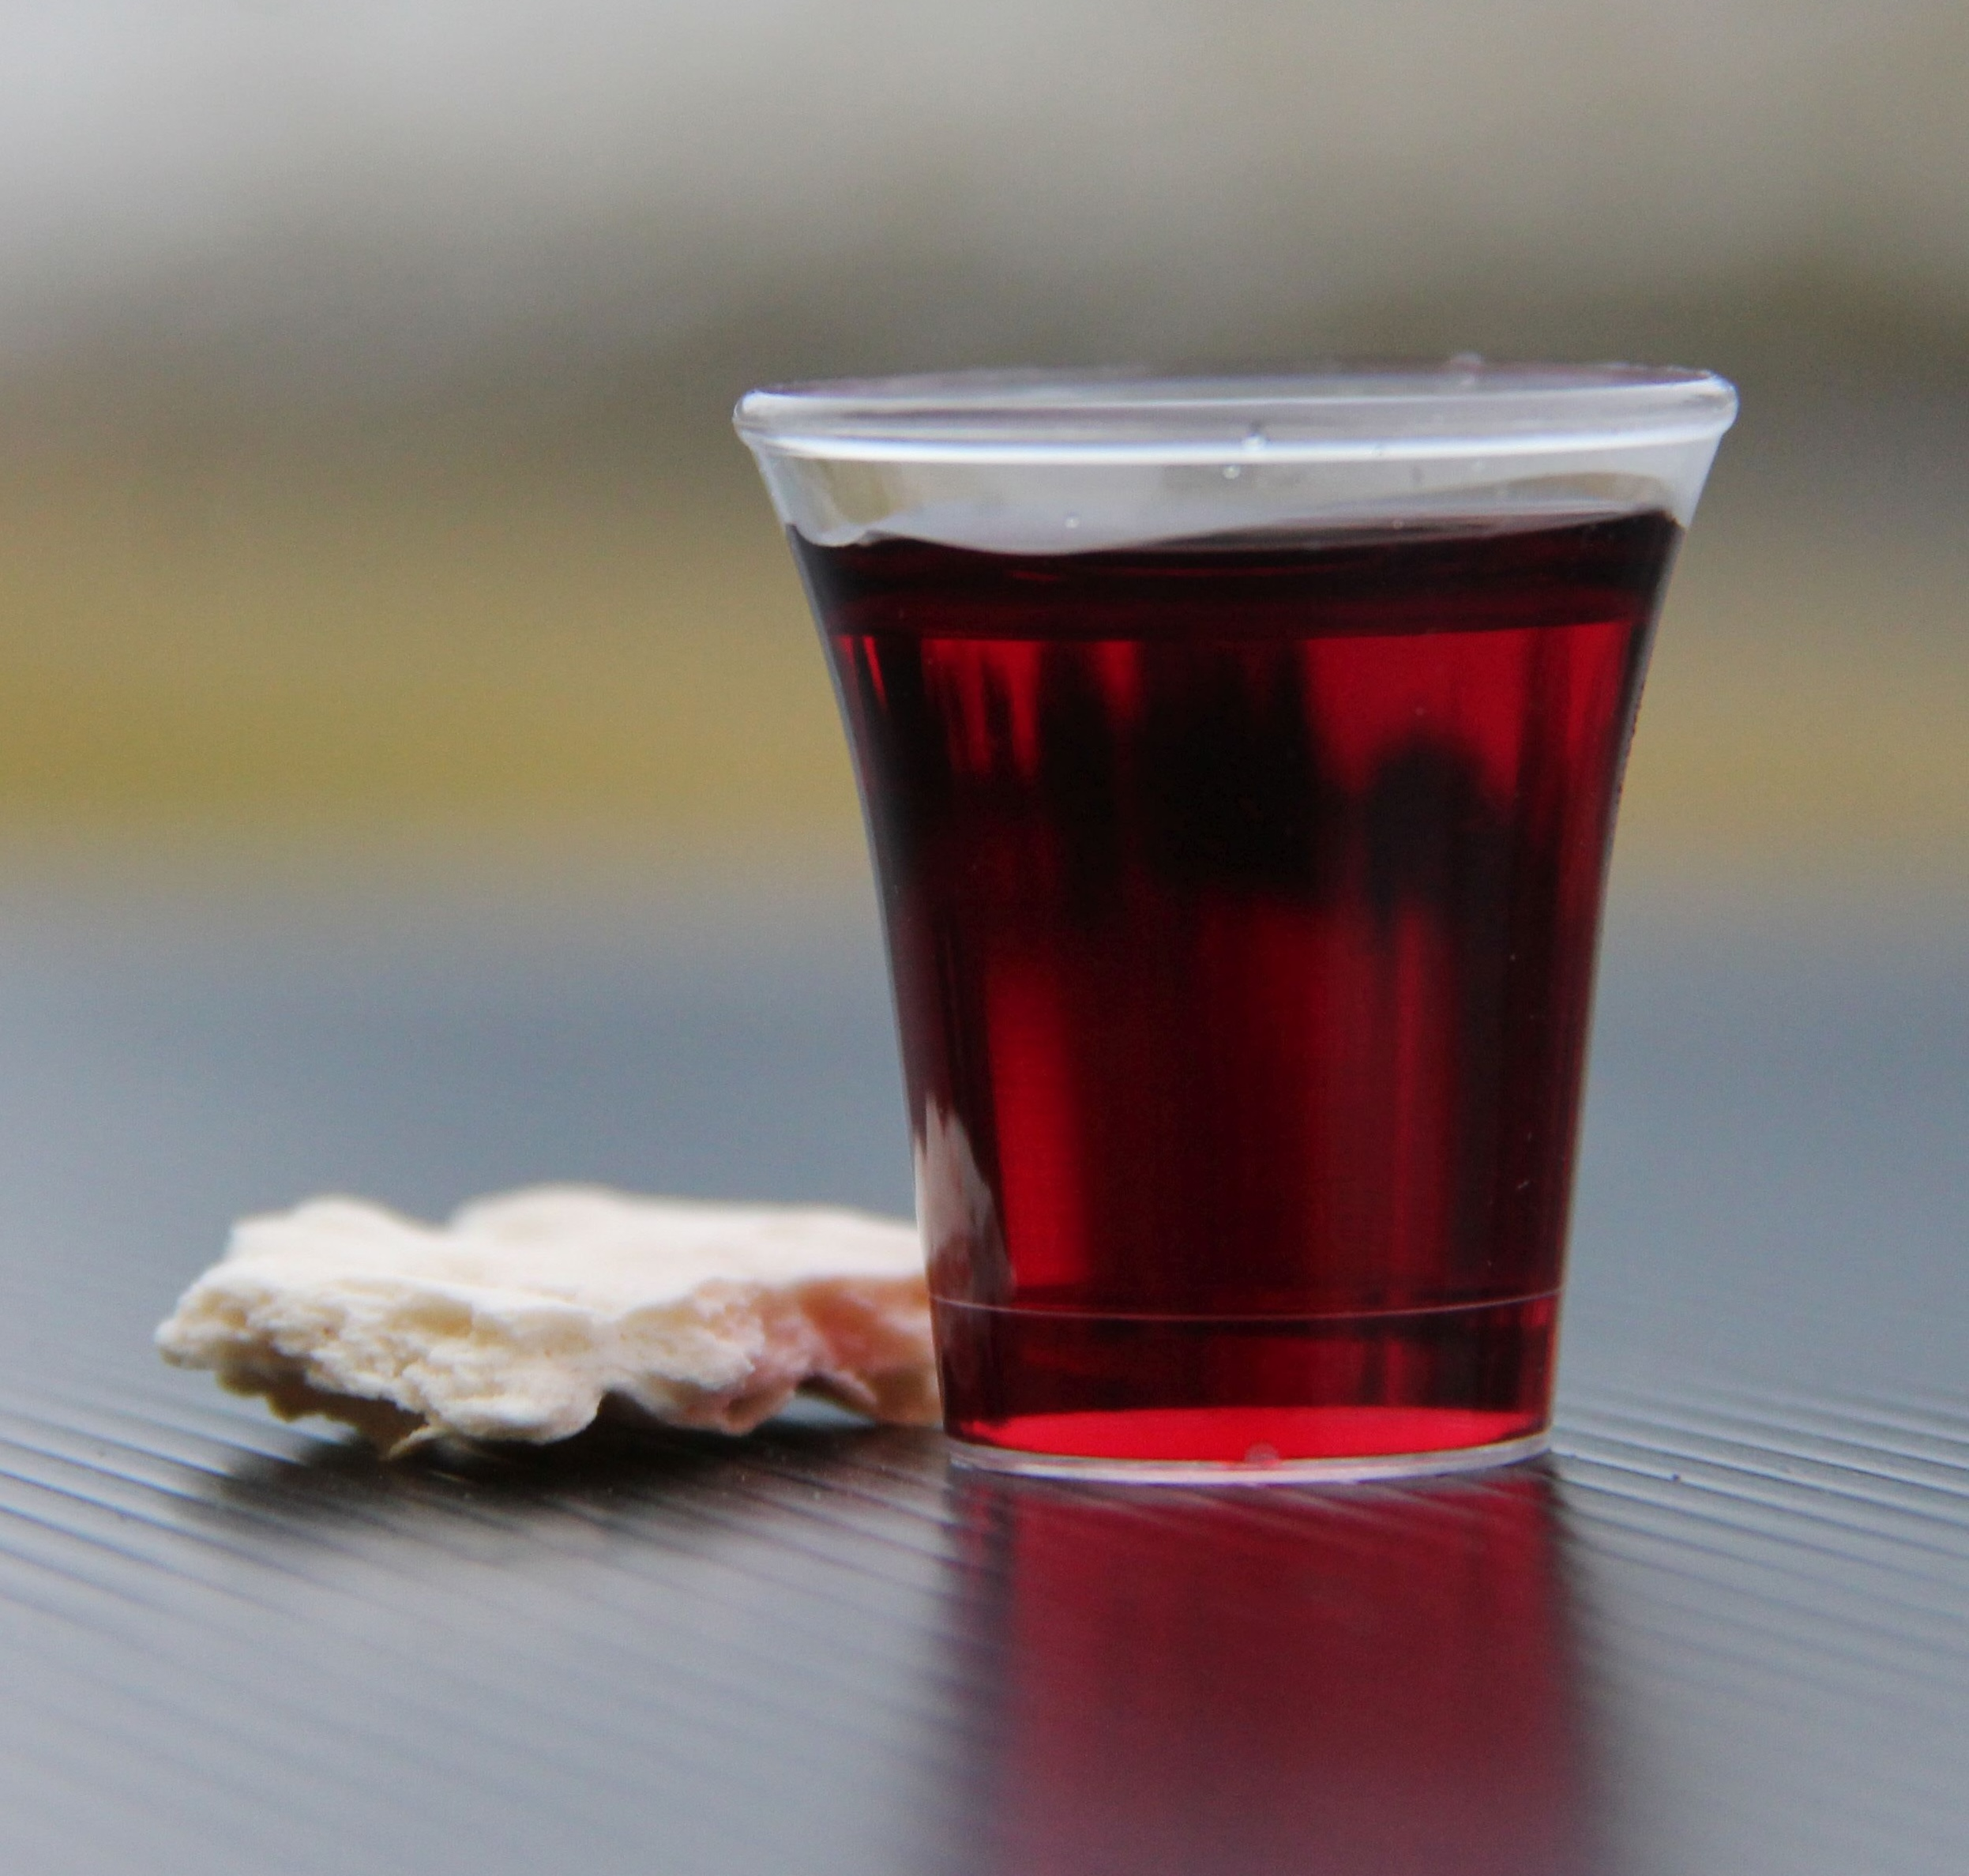
Holy Communion

Slide 38

Bible reading

Slide 39
Bible reading: Ephesians 1:15-23
¹⁵ For this reason, ever since I heard about your faith in the Lord Jesus and your love for all God’s people, ¹⁶ I have not stopped giving thanks for you, remembering you in my prayers.

Slide 40
Bible reading: Ephesians 1:15-23
¹⁷ I keep asking that the God of our Lord Jesus Christ, the glorious Father, may give you the Spirit of wisdom and revelation, so that you may know him better. ¹⁸ I pray that the eyes of your heart may be enlightened in order that you may know the hope to which he has called you, the riches of his glorious inheritance in his holy people,

Slide 41
Bible reading: Ephesians 1:15-23
¹⁹ and his incomparably great power for us who believe. That power is the same as the mighty strength ²⁰ he exerted when he raised Christ from the dead and seated him at his right hand in the heavenly realms,

Slide 42
Bible reading: Ephesians 1:15-23
²¹ far above all rule and authority, power and dominion, and every name that is invoked, not only in the present age but also in the one to come. ²² And God placed all things under his feet and appointed him to be head over everything for the church,

Slide 43
Bible reading: Ephesians 1:15-23
²³ which is his body, the fullness of him who fills everything in every way.

Slide 44
Announcements

Slide 45





Account name: Blacktown Chinese Christian Church
Account number: 4216 50263
Offering
BSB: 112 - 879
Please put in "offering" as the reference
The offering box is available at the back of the hall

Slide 46
Prayer points

Slide 47
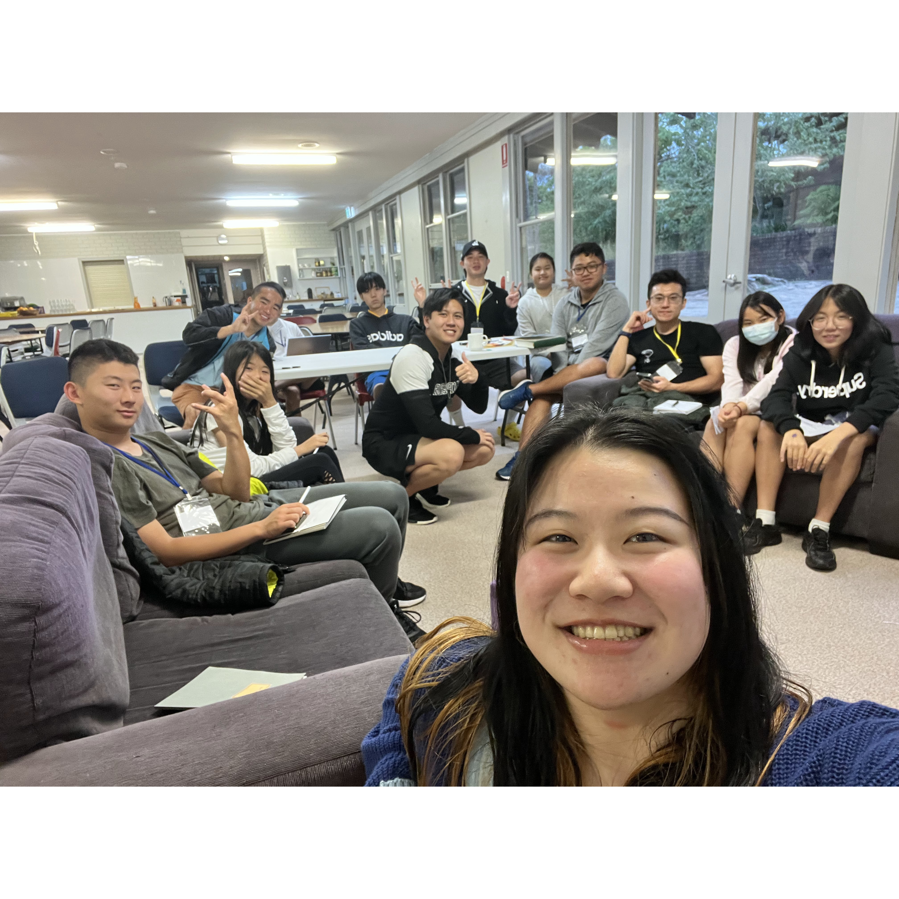
Mingle time!

